Slide 1
ALUMNI TALK
FROM COLLEGE
TO CAREER
</>
Building skills, products & opportunities
Hari Om Vishwakarma
Flutter Developer • Freelancer • Flutter Kanpur Co-organiser • Backend Developer
Notes:
Thank you for having me. A few years ago I was sitting exactly where you are — without everything figured out. I didn't know if I'd freelance, do backend, or organise a community. Today isn't just about technology; it's about the journey from student to someone who can build things, work with clients and create opportunities.
INTERACTION: 'How many of you already know exactly what you want to do after college?' ... 'How many are still figuring it out?' ... 'If you're in the second group, don't worry. I was there too.'

Slide 2
THE STARTING POINT
I was sitting where you are
COLLEGE
↓
“
CONFUSION
You don't need the entire roadmap.
You just need to take the next step.
↓
EXPLORATION
↓
BUILDING
↓
OPPORTUNITIES
Notes:
In college there's pressure to have it all figured out — Android? Web? Flutter? AI? Placements? Freelancing? With so many options, sometimes we end up doing nothing.
The lesson I learned after college: you don't need the entire roadmap, just the next step. My journey wasn't a straight line — I tried things, made mistakes, built projects, worked with clients, got involved in the community, and later explored backend.
So instead of telling you what you SHOULD become, I'll show you how to start becoming useful.

Slide 3






SIX STAGES, ONE PATH
My journey
College
Development
Flutter
Freelancing
Community
Backend
Each stage came because of the previous one.
“Your career is not a single decision. It's a series of decisions.”
Notes:
My journey in stages: college and exploration → development, learning how software actually works → Flutter became central → freelancing, where I learned code is only one part of the job → community, meeting developers and designers through Flutter Kanpur → and recently, going deeper into backend.
Notice: these aren't separate things. Each stage came from the previous one. You don't suddenly become 'successful' — you build one skill, then another, then another opportunity.
KEY LINE: 'Your career is not a single decision. It's a series of decisions.'

Slide 4
THE BIGGEST LESSON
Don't just learn.
Build.
WATCH
→
BUILD
→
BREAK
→
DEBUG
→
LEARN
→
REPEAT
Real learning happens when things break — and you fix them.
Notes:
Probably the biggest takeaway today. Students spend months learning — a YouTube video, a course, another tutorial — and after six months they know theory but haven't built anything.
There's a big difference between knowing how something works and being able to build with it. When you build, things break: the API fails, the UI breaks, the app crashes. You Google, ask AI, read docs, try again. THAT process is where real learning happens.
EXAMPLE: 'If you're learning Flutter, don't spend three months only on widgets. Build a small app. Even a terrible one. Finish it. Then improve it.'

Slide 5





LESSONS BEYOND THE FRAMEWORK
What Flutter taught me
UI
STATE
API
DEBUGGING
SHIPPING
How users interact
with software
How data changes
over time
Apps connect to systems
beyond the screen
Random changes
aren't a fix
Unused features
aren't useful
“A feature isn't really useful until someone can actually use it.”
Notes:
Flutter became central to my journey — but the biggest things it taught me weren't really about Flutter.
UI taught me how users interact with software. State management taught me how data changes. APIs taught me an app is connected to systems outside the screen. Debugging taught me that randomly changing code isn't a solution. And shipping taught me: a feature isn't useful until someone can actually use it. That's a very different mindset from college assignments.
INTERACTION: 'How many of you have built an app but never actually released it?' ... 'That's okay. But your next goal should be to actually ship something.'

Slide 6
THE BUSINESS SIDE
Freelancing is more than coding
FIND
→
UNDERSTAND
→
ESTIMATE
→
COMMUNICATE
BUILD
→
DELIVER
→
SUPPORT
“Communication is also a technical skill.”
Clients don't care how many languages you know. They have a problem — they want it solved.
Notes:
Freelancing taught me something very quickly: the client doesn't care how many languages you know. They have a problem and want it solved.
It's not just 'client gives requirement → I write code → I get paid.' It's: find the client, understand what they actually need, ask questions, estimate, communicate clearly, build, handle changes, fix bugs, deliver — and sometimes support afterwards.
KEY LINE: 'Communication is also a technical skill.' You can be an excellent programmer, but if you can't explain your work, understand requirements, or communicate delays, working with clients becomes very difficult.

Slide 7

FLUTTER KANPUR
Why community?
LEARN
SHARE
Learn faster around people who are also building
Teaching what you learned yesterday makes it stick
CONNECT
BUILD
Meet the developers, designers & mentors around you
Organising events builds leadership & confidence
“You don't have to be an expert to contribute to a community.”
Notes:
Then came community — I'm a co-organiser of Flutter Kanpur. You learn a lot faster when surrounded by people who are also building. Meeting developers shows you how others solve problems. Talking to designers changes how you see things. Organising an event teaches communication and leadership. Speaking in front of people makes you better at explaining. Helping someone else often makes YOU understand the concept better.
STRONG MESSAGE: 'You don't have to be an expert to contribute.' Beginners can share what they're learning, help someone with yesterday's lesson, volunteer, organise, ask questions, build connections.
TIP: Replace/augment this slide with 2-3 real photos from Flutter Kanpur events — it lands much better.

Slide 8
THE WORLD BEHIND THE SCREEN
Why I'm learning backend
FLUTTER APP
The user taps a button — and an entire hidden system responds.
↓
API
↓
Requests, processing, databases, auth, storage, deployment — the mobile app is only one piece of the product.
BACKEND
↓
DATABASE
Go deep in your primary skill,
but understand the ecosystem around it.
↓
DEPLOYMENT
Notes:
For a while I was focused only on mobile. But on real products you realise the app is just one piece: the user taps a button → the app sends an API request → the backend processes it → talks to a database → auth happens somewhere → files are stored somewhere → everything is deployed somewhere. There's an entire world behind the screen. That's why I've been going deeper into backend.
IMPORTANT: I'm not saying everyone must become full-stack. The point is: go deep in your primary skill, but understand the ecosystem around it.

Slide 9
HONEST ADVICE
8 things I wish I knew in college
1
2
3
4
Start building earlier
Your first project can be bad
GitHub is proof of work
Communication is a skill
Projects teach more than endless preparation.
Ugly and buggy is fine. Finish it.
Show what you built — don't just claim it.
Explain decisions, ask questions, flag problems.
5
6
7
8
Don't chase every tech
Use AI — understand it
Build your network early
Don't wait to feel ready
Pick one thing and go deep.
Speed is great. Blind copying isn't.
Meet people before you need a job.
You almost never will. Start anyway.
Notes:
Spend ~30-45 seconds each:
1) Building projects beats endlessly preparing to build.
2) Your first app is allowed to be ugly and buggy — finish it.
3) Don't just write 'Flutter Developer' on a resume — show what you built.
4) Learn to explain decisions, ask questions, communicate problems.
5) You don't need every technology. Pick something, go deep.
6) AI makes you dramatically faster — but don't copy code you don't understand.
7) Meet developers BEFORE you need a job. Relationships shouldn't start at referral time.
8) You'll almost never feel completely ready. Start anyway.

Slide 10




YOUR CHALLENGE
30
1 project — built and finished
1 GitHub repository — public
5 developer connections
DAYS
1 community event attended
Not a job. Not expertise.
Momentum.
1 thing learned every day
Notes:
I don't want you to feel motivated for two hours and forget everything tomorrow. So: give yourself 30 days.
Build ONE project and finish it — expense tracker, weather app, chat app, college management system, anything. Put it on GitHub. Connect with five developers. Attend one community event. Learn one meaningful thing every day.
CLOSE: 'At the end of 30 days, you might not have a job. You might not be an expert. But you'll have something much more important — momentum.'

Slide 11
DON'T WAIT
TO BE READY.
Start. Build. Break. Learn. Share. Repeat.
Notes:
SLOW DOWN HERE. If you remember only one thing from today: don't wait to be ready.
You don't need to know everything before starting. You don't need the perfect laptop, the perfect project, five languages, thousands of followers, or expert status. Start with what you know. Build something. Break it. Fix it. Learn something. Share it. Do it again.
PAUSE. Then: 'A few years from now, you might look back and realise that one small project you started in college was actually the beginning of your career.'

Slide 12
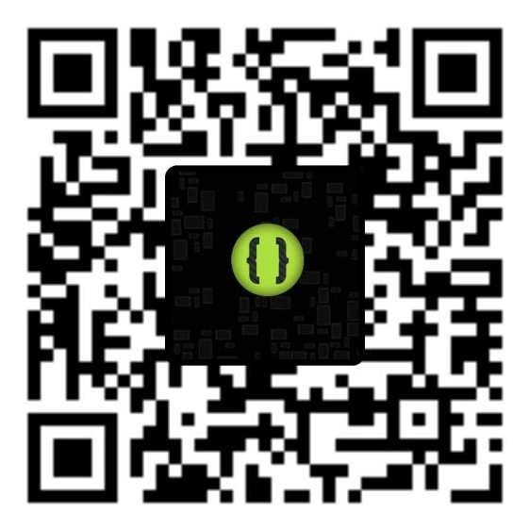
THANK YOU
LET'S CONNECT
Hari Om Vishwakarma
Flutter Developer • Freelancer
Flutter Kanpur Co-organiser • Backend Developer
Scan the QR →
One scan — LinkedIn, GitHub, Instagram & Flutter Kanpur.
SCAN TO CONNECT
I'd love to hear your questions.
Notes:
That's what I wanted to share. I haven't figured everything out — I'm still learning, still building, still making mistakes. That's the point: your career doesn't become complete one day; you keep learning and keep moving.
Start building something. Find people who are building too. Help each other. Don't be afraid to try things before you feel ready. Point at the QR: 'Scan this to connect with me.' Leave this slide up during Q&A so people can scan.
Q&A WARM-UP (don't wait in silence): 'How many of you are interested in development?' → 'How many in freelancing?' → 'How many want to start something of their own?' Use the hands to kick off Q&A.

